Slide 1
LISTENING TO ISRAELI AND PALESTINIAN PEOPLE WHEN WE SEE VIOLENCE IN THE MEDIA

Slide 2
AS A SCHOOL, WE CARE
Israel-Palestine has been in the news recently. As a school we care about the people there who have been suffering due to the violence, and about those in our own school community who may affected in any way. Today, we are using these slides from an organisation called Solutions Not Sides to:
Provide, as a school, the opportunity to express concern about this issue in a way that is civil and respectful to all members of our community
Explore some of the historical narratives from both perspectives
Reflect on how ordinary people have been affected in recent events
Consider an approach that is centred on finding solutions rather than supporting one side against the other
Let’s start with taking a moment to reflect on whether this issue is important to us personally, and if so, why we feel that it is important.
Notes:
Israel-Palestine has been in the news recently. As a school we care about the people there who have been suffering due to the violence, and about those in our own school community who may affected in any way. Today, we are using these slides from an organisation called Solutions Not Sides to:
Provide, as a school, the opportunity to express concern about this issue in a way that is civil and respectful to all members of our community
Explore some of the historical narratives from both perspectives
Reflect on how ordinary people have been affected in recent events
Consider an approach that is centred on finding solutions rather than supporting one side against the other
Let’s start with taking a moment to reflect on whether this issue is important to us personally, and if so, why we feel that it is important.

Slide 3
What positions do people in the UK take on Palestine and Israel?

Slide 4
FREE PALESTINE
VS.
SAVE ISRAEL
Notes:
For many different reasons, people often support these positions of free Palestine or save Israel. It is natural and good to show sympathy and concern for the people on either side, especially if you know some people personally. However, those positions can get stuck, and we end up doing very little to help the people on the ground to find a way forward to a better life
It can be helpful to try and understand how people think and feel about it, without any pressure to agree. This is so we can have a civil discussion about a difficult topic

Slide 5
Notes:
The tip of this iceberg represents those two positions that many people in this country who are pro-Palestine or pro-Israel support. But under the water are all the reasons why they might hold those positions
What are some of the reasons for why people feel a strong sense of sympathy or support for Palestine and Israel?

Slide 6
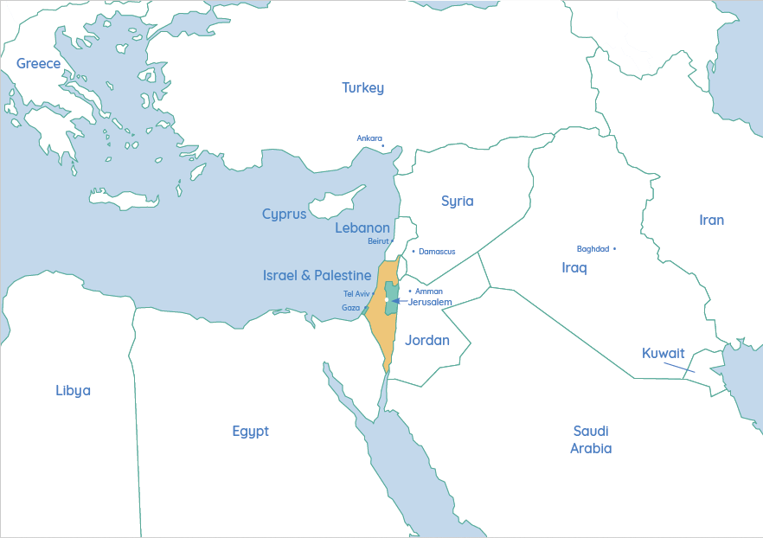
Notes:
Let’s have a deeper conversation now, focusing on the situation for the ordinary people on the ground
The region we are speaking about is situated here on the eastern side of the Mediterranean Sea
These two areas are known as Israel (yellow) and Palestine (green), or you may also hear Palestine referred to as the Occupied Palestinian Territories. The whole area with both together is only about the size of Wales, so it is quite a small territory
Israel and Palestine are two national movements who both want to have their state in this piece of territory and the borders you see here are based on international resolutions but have not yet been agreed upon or implemented by the Israeli and Palestinian leadership. For this reason, you may have seen maps that do not show these borders and refer to all the land as only Palestine or Israel

Slide 7
Settlement
Separation barrier
Area C
Area A
Area B
Nature reserve
Notes:
In addition, the blue areas that you see here in the West Bank are under Israeli control and Palestinians only have the pink areas under their own control
The yellow areas are under joint control
The red dots are Israeli settlements where Israeli citizens are living in Palestinian areas, which are illegal under international law

Slide 8
Notes:
This is known under international law as an occupation of Palestinian land and Palestinians want it to end.

Slide 9
Notes:
Palestinians say that they would like settlement expansion to stop and that the loss of land due to these settlements be addressed in any peace negotiation.

Slide 10
Notes:
Palestinians in Gaza live under Palestinian rule, but there is a blockade on Gaza that Palestinians want to end.

Slide 11
Notes:
Israelis, particularly those living near the border with Gaza, suffer from rocket attacks by Palestinian militants that they want to end. Around 10 Israelis have been killed in the most recent escalation of violence.

Slide 12
Notes:
Palestinians suffer from Israeli air strikes on Gaza that they want to end. Over 200 Palestinians have been killed in the most recent escalation of violence.

Slide 13
Notes:
Israelis also want to ensure that in the future, they can live safely without fear of attacks being carried out against unarmed civilians. At the height of the Palestinian uprising in the early 2000s, there was a bomb almost every day for a year in Israel and many still live with that trauma.

Slide 14
Notes:
Palestinian citizens of Israel have been campaigning recently alongside Jewish Israelis for equality and counter-racism through large demonstrations in the major cities of Israel.

Slide 15
Notes:
There are other needs and interests that both Palestinians and Israelis have that you can learn about in a full Solutions Not Sides programme. However, the bottom line is that they are all people, just like us, who deserve a life of dignity, freedom and peace
Many people hurt are children who have inherited this situation from the previous generations. In order to make a change for the future, we need to understand something of what happened in the past

Slide 16
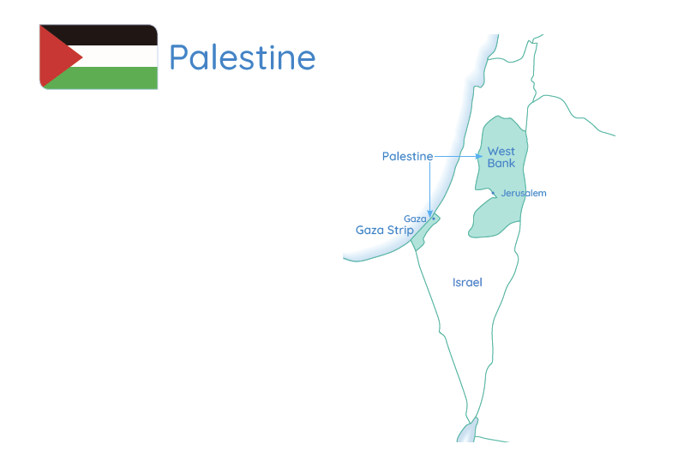
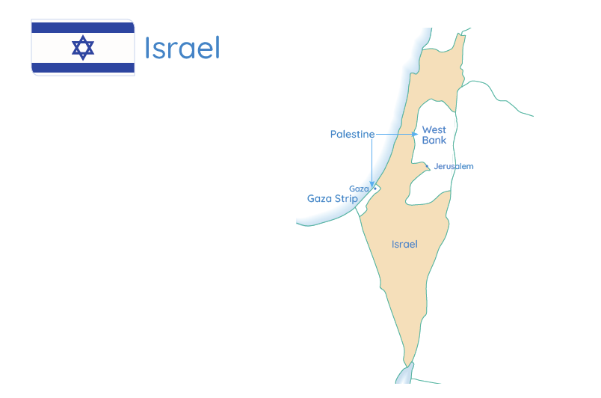
EXPLORING THE HISTORY
Watch the video: Israel-Palestine: A Beginner’s Guide
Notes:
We are now going to watch a 20-minute short film about the history of the region, in which an Israeli and a Palestinian will share some of their societies’ reflections on the history
After watching the video, you will be welcome to share some of your reflections about why each side wishes to have a home in this land

Slide 17
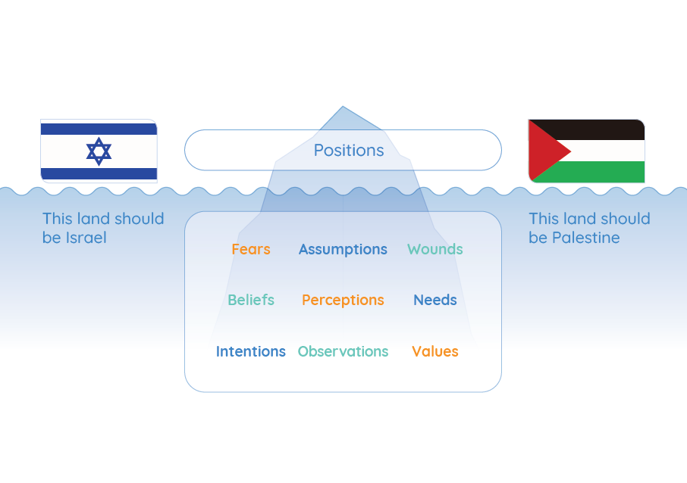
Notes:
Share some reflections about why each side wishes to have a home in this land.

Slide 18
Notes:
Many Israelis see Israel as a place where they should be able to live freely and safely as Jews.

Slide 19
Notes:
Many Palestinians see Palestine as a place where they should be able to live freely and safely as Palestinians.

Slide 20
Notes:
Because we care about the people of Palestine and Israel, we want to see a future in which there is a just and peaceful solution for them. If we support one side to win against the other, then the violence and pain will continue and so will the current situation of…

Slide 21
Notes:
Lose-lose.

Slide 22
Notes:
As you talk to friends and family and do further research on this issue, think about what a win-win outcome could look like. There are millions of Palestinians and Israelis living in this piece of land and they need to find a way to coexist.

Slide 23
Palestine
Notes:
Should the two-state solution be properly implemented with East and West Jerusalem as the capitals of the two states?

Slide 24
Notes:
Should there be some form of single, bi-national state, or perhaps a confederacy where the two states have a certain level of independence but have collaboration on some things?

Slide 25
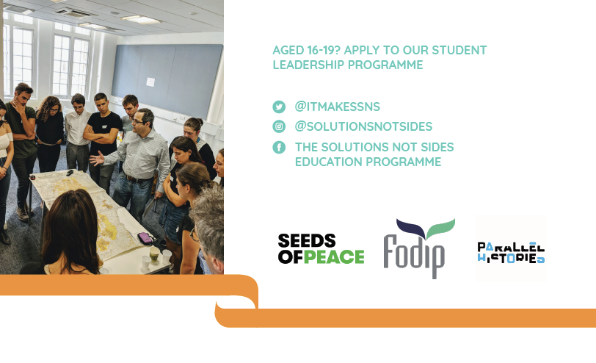
Visit our blog for a guide to avoiding hate speech around this topic!
CHECK OUT FURTHER OPPORTUNITIES WITH OUR PARTNERS:
Notes:
Remember to keep the lives of Palestinians and Israelis and what they need at the heart of your activism – both sides are human beings and deserve our support to demand an end to the violence from their leaders
The media has many different voices on this issue and a lot are biased towards one side or the other. Follow Solutions Not Sides online for more information and resources. Every week, they issue a news update on current events in Israel-Palestine that draws from diverse news sources so that you can get a broader picture of what is going on
There are also some other organisations that offer opportunities for British young people to learn and discuss more about the topic
Look out for the SNS hashtag campaign #IfTheyCanWeCan on social media highlighting example of Israelis and Palestinians standing together to hold their leaders to account and demand peace

